Slide 1

Spectral Filtering-Based Anomaly Detection Capstone Project Phase A – 61998 25-2-R-11
Students:
Itay Mohabati | Shai Yosef
Supervisors:
Dr. Renata Avros | Prof. Zeev Volkovich

Slide 2
Table of contents
01
02
03
04
05
Problem Definition
Project Goal
Workflow
Insights and Applications
Testing Plan

Slide 3
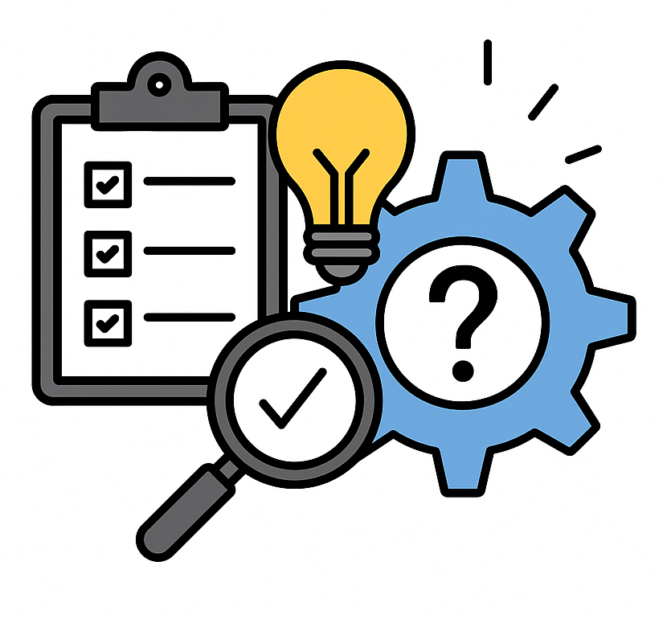
01
Problem Definition

Slide 4
Problem Definition
Detecting anomalous nodes in attributed networks based on deviations within their communities.
KEY CHALLENGES:
Scalability: Efficient methods are needed to handle large graphs with high-dimensional data.
Context-Aware Detection: Anomalies must be identified based on deviations within local communities, not the entire graph.
Smoothness Measurement: Measuring signal disruption in spectral space is complex and requires robust filtering.

Slide 5

02
Project Goal

Slide 6
Project Goal
To develop a scalable framework for detecting anomalous nodes in attributed graphs with community structure using a spectral filtering-based approach (SpecF).
Objective:
How the Framework approaches the Problem:
Scalability: Use of GCN and GraphSAGE to produce low-dimensional, efficient embeddings.
Context-Aware Detection: K-means clustering defines communities, enabling local anomaly detection.
Smoothness Measurement: SpecF applies spectral filtering to quantify deviations from community norms.

Slide 7

03
Workflow

Slide 8
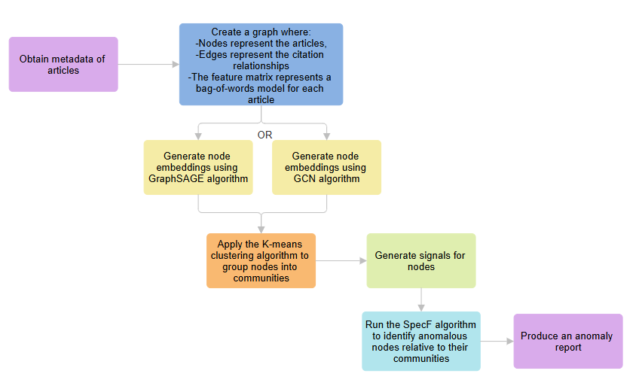

Slide 9
Data Preproccessing
Purpose:
Steps:
To transform raw, noisy graph data (nodes, edges, features) into a structured graph representation that enables accurate, scalable, and meaningful anomaly detection using GCN/GraphSAGE, clustering, and SpecF.
Collect article metadata
Build the Graph
Clean the Graph
Extract Node Features – Bag of words
Define initial node signal

Slide 11
Graph Embedding with GraphSAGE
What is GraphSAGE?
Steps (High-Level):
An inductive graph neural network that learns node embeddings by sampling and aggregating features from neighbors.
Samples a fixed number of neighbors for each node.
Aggregates their features using functions like mean or max pooling.
Combines aggregated features with the node’s own features to update its representation.
Purpose:
To generate scalable and generalizable node embeddings by sampling and aggregating neighbor features, enabling effective clustering and anomaly detection in large or dynamic graphs.

Slide 12
Graph Embedding with GCN
What is GCN?
Steps (High-Level):
A neural network model that learns node representations by combining their features with those of their neighbors.
Uses the graph structure to aggregate neighbor information.
Applies layers that combine feature vectors across connected nodes.
Produces embeddings that reflect each node’s context in the network.
Purpose:
Generate node embeddings that capture both the graph structure and node features - essential for tasks like clustering and anomaly detection.

Slide 14
K-Means Clustering
What is K-Means?
Steps (High-Level):
K-means is an unsupervised clustering algorithm that groups data points (e.g., node embeddings) into K clusters based on their similarity.
Randomly choose 𝐾 cluster centroids.
Assign each data point (e.g., node embedding) to the nearest centroid.
Recalculate centroids as the mean of all points in each cluster.
Iterate assignment and update steps until centroids stop changing.
Purpose:
To group nodes into communities by clustering their embeddings based on feature similarity, providing a structural basis for context-aware anomaly detection.

Slide 16
Signal Generation
What is Signal Generation?
Steps (High-Level):
Signal Generation creates node signals based on community structures in the graph.
Compute community-level signals.
Assign signals to high-degree nodes (community heads).
Propagate signals through the network with community-aware weights.
Normalize node signals using weighted neighbor averages.
Purpose:
Assign a meaningful, smooth signal to each node, reflecting community structure.

Slide 17
Anomaly Injection
What is Anomaly Injection?
Steps (High-Level):
Anomaly Injection simulates abnormal behavior by increasing signal values of selected nodes beyond their community norms.
Select a random subset of nodes as anomalies.
For each, find the maximum signal in their community.
Increase their signal by a random factor above this maximum.
Output the modified signal vector with injected anomalies.
Purpose:
Create known anomalies for testing and evaluating the accuracy of anomaly detection algorithms.

Slide 19
SpecF – Spectral Filtering for Anomaly Detection
What is SpecF?
Steps (High-Level):
An unsupervised method based on graph signal processing, which applies a low-pass spectral filter to highlight nodes that disrupt smooth community-level patterns.
Apply Graph Fourier Transform to convert node signals into the frequency domain.
Use a low-pass filter to smooth signals and remove high-frequency (anomalous) components.
Compare original and filtered signals, then use community-based thresholds to identify anomalous nodes.
Purpose:
To detect anomalies by identifying nodes whose feature signals deviate from the expected smoothness within their own community.

Slide 21
Anomaly Report
Purpose:
Summarize and present the results of the anomaly detection process in a clear, actionable format.
What the Anomaly Report Contains:
List of detected anomalous nodes.
Node details (article title, community, Deviation Score, etc..)
Summary of anomalous nodes per community, highlighting which communities show more anomalies.

Slide 22

04
Insights and Applications

Slide 23
Insights and Applications
Insights
Applications
Community-aware analysis improves anomaly detection accuracy over global methods.
Spectral filtering uncovers subtle signal disruptions not visible through raw features alone.
Embedding-based clustering allows flexible, scalable handling of complex graphs.
The modular design (Embedding → Clustering → Filtering) enables adaptability across domains.
Cybersecurity – Detect suspicious behavior within internal network segments.
Fraud Detection – Identify anomalies in transaction or account networks.
Bioinformatics – Spot irregularities in protein interaction or gene co-expression networks.
Social Media – Find bots or malicious users based on community dynamics.
Smart Cities / IoT – Flag malfunctioning or abnormal sensors in smart infrastructure.
Epidemiology – Monitor spread deviations in district-wise disease data (e.g., COVID-19 case spikes).

Slide 24

05
Testing Plan

Slide 25
Testing Plan
1 | FontsClean graph with valid structure | Ensure that CitationNetwork removes duplicates and self-citations and produces the correct node-feature structure | CitationNetwork
2 | Valid embedding vectors | Verify that the embeddings generated using either use_gcn() or use_graphsage() are correctly shaped and non-empty | GraphEmbeddingGenerator
3 | Embeddings match input size | Ensure the number of embeddings equals the number of nodes provided in CitationNetwork | GraphEmbeddingGenerator
4 | Nodes clustered into expected number of groups | Validate that KMeans assigns a cluster label to each node and respects the defined number_of_clusters | KMeansClustering
5 | Expanded matrix constructed correctly | Check that the construct_expanded_matrix() method in SpecFProcessor builds a matrix using the fixed weights defined for edge and community relationships | SpecFProcessor
6 | Signal is properly filtered | Ensure that apply_spectral_filtering() performs Fourier Transform and filtering without error and returns smoothed signals | SpecFProcessor

Slide 26
Testing Plan
7 | Deviations are computed accurately | Validate that compute_deviation() returns a list of absolute differences between raw and filtered signals | SpecFProcessor
8 | Anomalies are detected using the correct threshold logic | Confirm that detect_anomalies() uses the formula: (mean + 2 * std) / max to flag outliers | SpecFProcessor
9 | Anomaly report is constructed correctly | Ensure that the report object is created and contains a list of detected anomalous nodes | AnomalyReport
10 | Object is passed between components correctly | Check that the anomaly report is successfully passed from AnomalyReport to EvaluationEngine | AnomalyReport / EvaluationEngine
11 | Consistency checks run correctly | Validate that consistency_checks() assesses the validity and coherence of the anomaly report | EvaluationEngine
12 | Final evaluation outputs result | Ensure that final_evaluation() produces interpretive or metric-based results based on input report | EvaluationEngine

Slide 27
Thanks!
Shai & Itay

